Slide 1

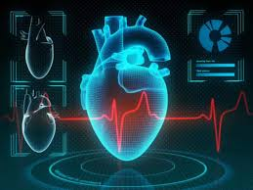
Project on
Heart Cancer Prediction
Shriya Singh
btech final year
Under the Guidance of - Dr. Sarwan Sir and
Ms. Anita Ma’am

Slide 2

Protect your heart

Slide 3
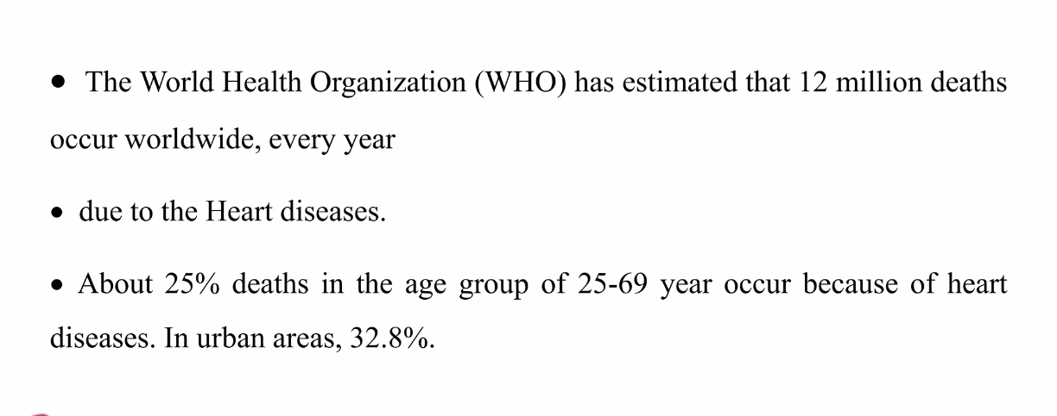
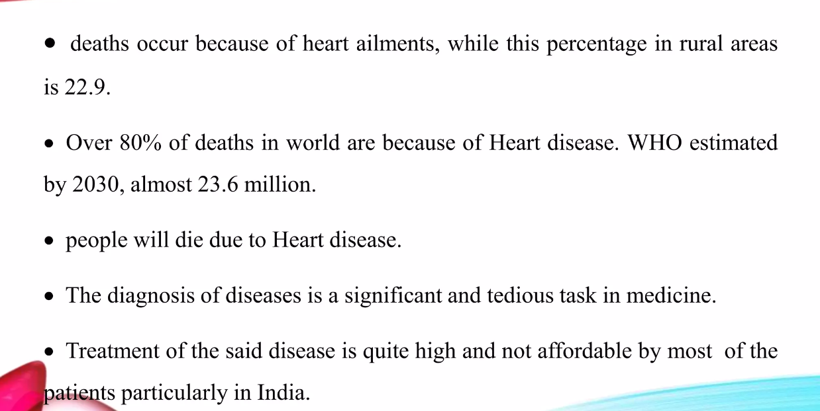


Slide 4
CONTENT
Overview
Dataset
Data Descriptions
Correlation Matrix
Performance Matrices
Models' Comparison
Actual v/s Predicted Values
Conclusion
prevention

Slide 5
Objective
To apply the Supervised Machine Learning Models (Decision Tree, Naive Bayes, KNN and Logistic Regression) to the Dataset and find corresponding performance matrices.
To compare the models on the basis of corresponding Accuracy, Precision, Recall, F1 Score, Kappa and MCC.

Slide 6
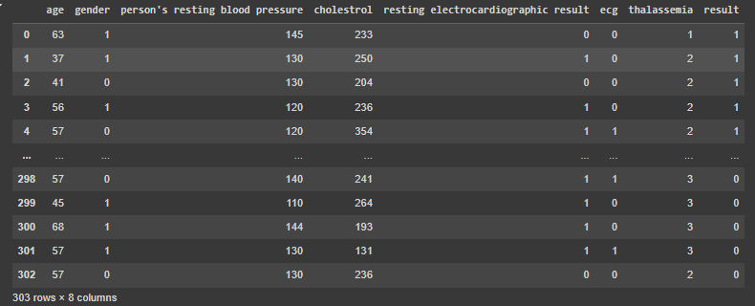
Dataset

Slide 7
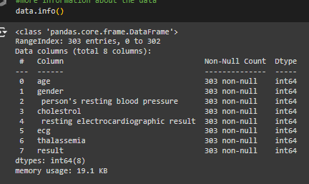
Data Information

Slide 8
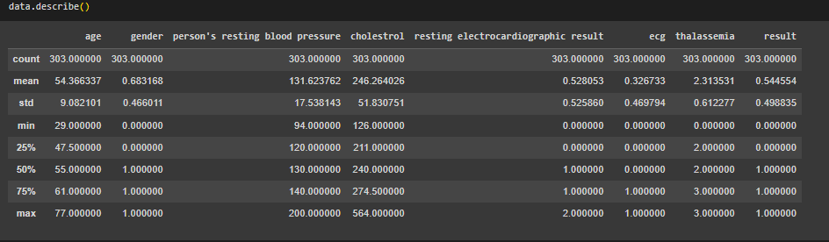
Data Description

Slide 9
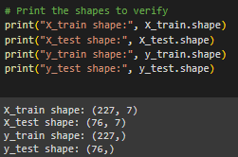
Training & Testing of the model

Slide 10
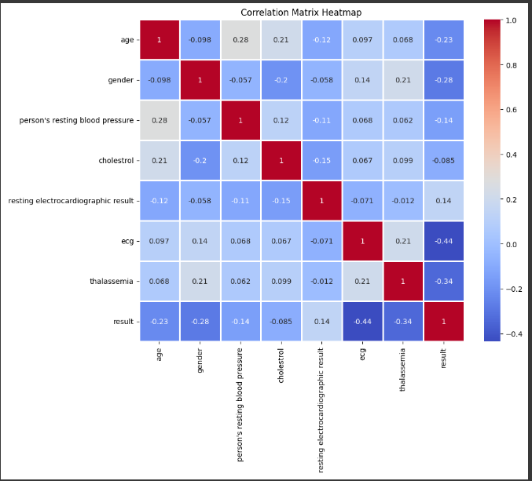
Correlation Matrix

Slide 11
Model Selection
Decision tree
Naïve Bayes
KNN
Logistic Regression

Slide 12
Model Evaluation and Comparison
This involves using appropriate metrics such as
accuracy,
precision,
recall
, and F1-score
to compare the models' predictive capabilities.
The model with the highest performance on the evaluation metrics will be selected as the final model for heart cancer prediction.

Slide 13
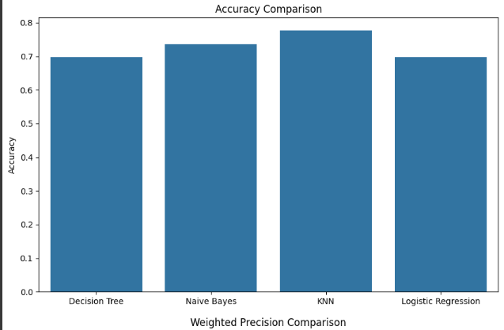
Performance Metrics
ACCURACY

Slide 14
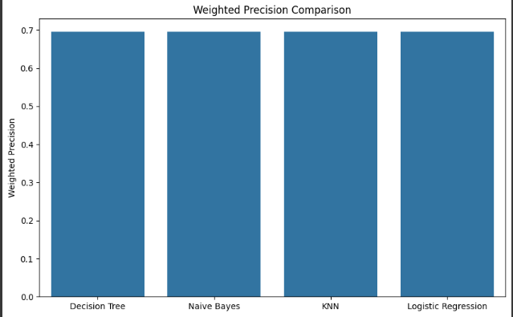
Precision

Slide 15
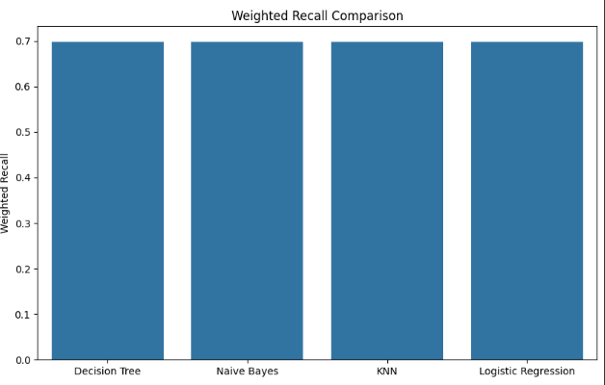
Recall

Slide 16
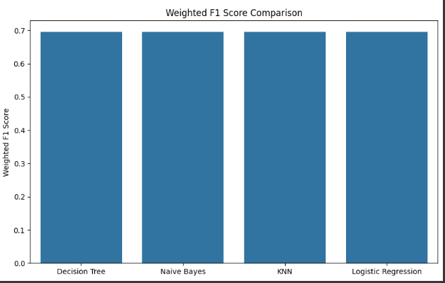
F1 Score

Slide 17
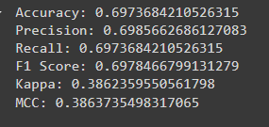
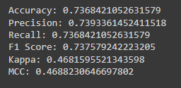
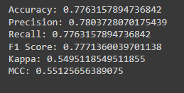
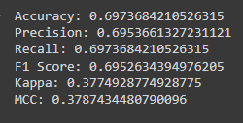
PERFORMANCE MATRICES by the MODELS

Slide 18
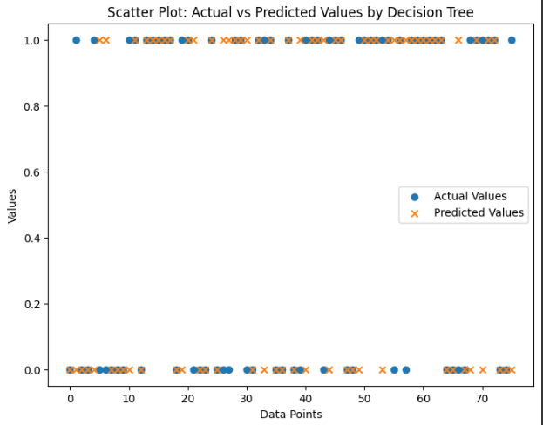
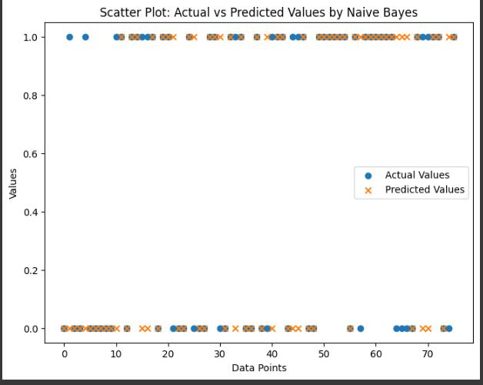
ACTUAL v/s PREDICTED VALUES

Slide 19
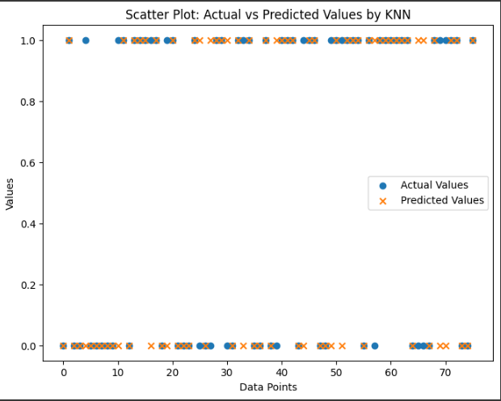
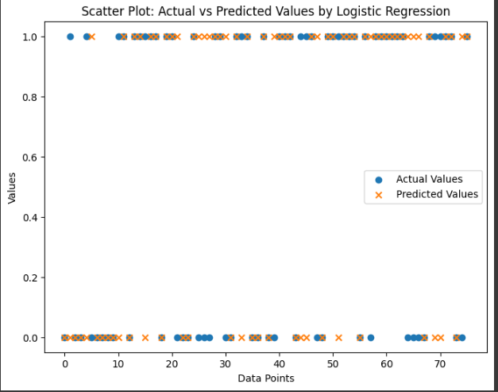

Slide 20
Check your health report !
Check your health...

Slide 21
CONCLUSION
i applied 4 Supervised learning models on HEART CANCER Dataset (Decision Tree, Naive Bayes, KNN and Logistic Regression) to the Dataset & compared the models on the basis of their performance matrices … i came to know that KNN is the most suitable model for my data.

Slide 22





REFRENCEs

Slide 23


